Slide 1
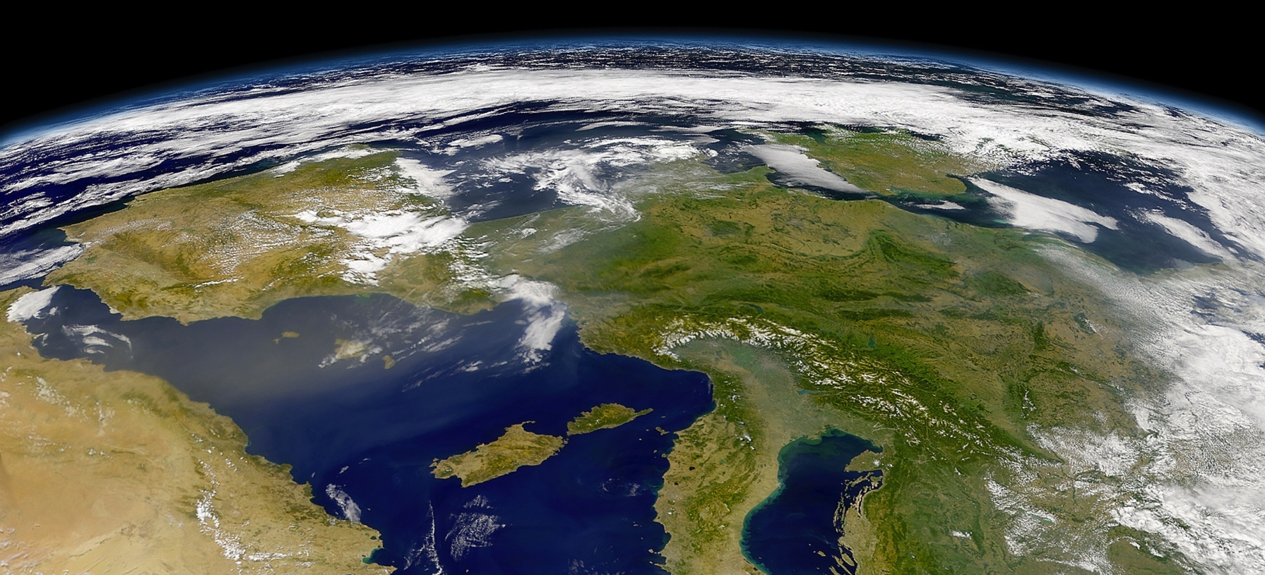
Introduction to R Programming
Marek Strejczek, Version 1.2, December 04, 2017

Slide 2
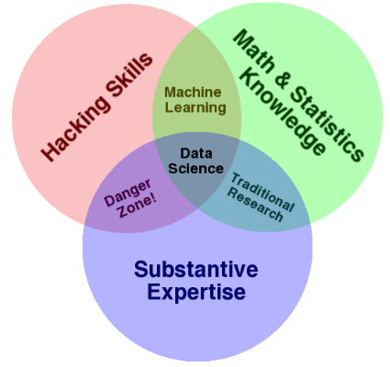
About me
Senior Architect at TomTom
  PU Maps, Automation and Business Analytics team
14 years of experience in software design and development
  Telco
  Finance
Specialized in Java technologies
Exploring the world of data-related technologies – looking for innovative ways of tackling problems

Slide 3
What is R
Language and environment for statistical computing and graphics
GNU project
Started in early 90’s
Similar to S language developed in 70’s
Very popular for statistical research. Provides packages for:
  Data access
  Data cleaning
  Analysis
  Reporting
Excels at interactive data exploration
Very active community

Slide 4
Statistical features
Many statistical and graphical techniques available out of the box or with additional packages
  Linear and non-linear modeling
  Statistical tests
  Time-series analysis
  Classification
  Clustering
Graphics (static, dynamic, interactive)
Lots of packages at Comprehensive R Archive Network (CRAN)

Slide 5
Showtime!
Vectors
Matrices
Lists
Factors
NA, NaN
Subsetting
Control structures: if, for, while, repeat
Functions
  *apply (apply, lapply, sapply, mapply, tapply), split
Statistics

Slide 6
Showtime!
Built-in datasets
Apache log analysis
Hospital data analysis
Useful package not explored during this demo:
  ggplot2 – plotting library
  data.table – extension to data frame, supports large datasets

Slide 7
Enterprisey solutions
Renjin – JVM based R interpreter
SparkR – R interface for Apache Spark
Enterprise solutions:
  Oracle Enterprise R – part of Oracle Advanced Analytics Option
    Can run R against data managed by Oracle database
  Microsoft R Server – enterprise class analytics platform based on R.
    Can intergrate with Hadoop, Teradata, SQL Server
    Based on Revolution Analytics – Big Data Analytics platform acquired in 2015 by Microsoft
    Recently (Sep 2017) rebranded to Microsoft Machine Learning Server.

Slide 8
Thank you
Any questions?

